Slide 1
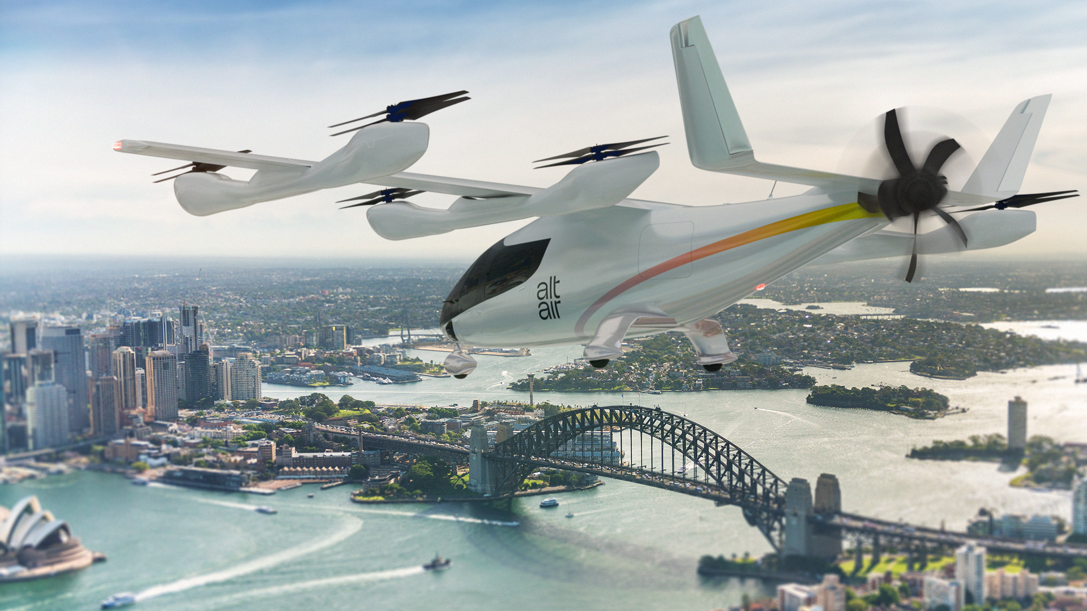

BRINGING ZERO-EMISSION REGIONAL AND URBAN AIR MOBILITY TO AUSTRALIA
Founders of Sydney Seaplanes building Australia’s first scalable air mobility network

Slide 2


INTRODUCING ALT AIR:
Swifter, Smoother, Smarter
Infrastructure owner, proven team, two states, one network.
Proven operator – Founders of Sydney Seaplanes. 20+ years, operated hundreds of thousands of UAM and RAM flights from Sydney Harbour.
Owned infrastructure – Long-term NSW Government leases over Rose Bay and Palm Beach – the launch platform.
Two-state network – NSW operations launching 2026. Queensland expanding from 2028.
The 2032 catalyst – Brisbane is hosting the largest sporting event on earth. AAM infrastructure built for the Olympics becomes permanent public transport legacy.
Strategic partnerships – Eve Air Mobility (50 eVTOL aircraft on order), Skyports Infrastructure (vertiport development).
Sydney Aviation Holdings
Infrastructure holder
Urban and Regional Air Mobility Operator

Slide 3
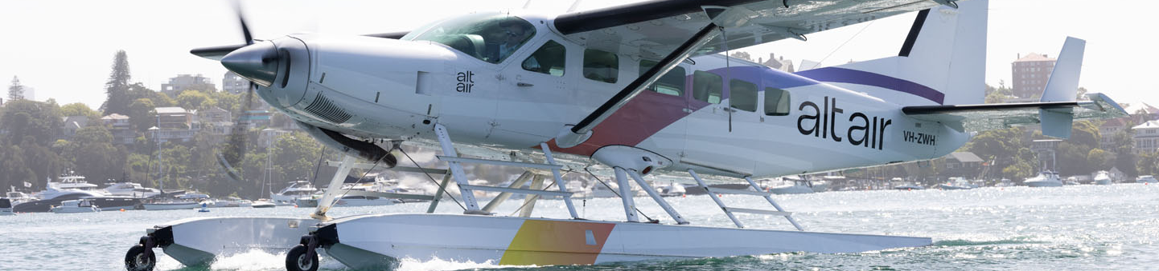
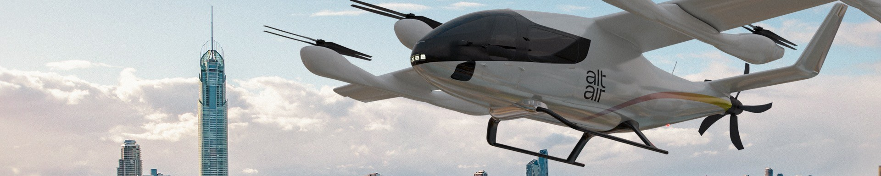
A phased pathway to scalable air mobility:
Alt Air is launching a staged, commercially viable pathway to electrified regional and urban air mobility — starting with proven operations and transitioning to next-generation aircraft as they become available.
2026
2028
2029
2032
Launch operations using existing certified aircraft
Introduce eVTOLs for early urban network operations
Introduce eCTOL electric fixed-wing aircraft
Full SEQ Olympic network operational

Slide 4
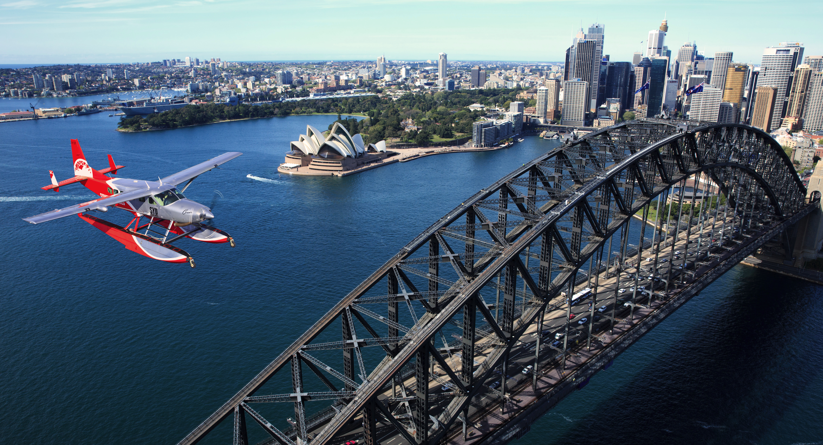
AMPHIBIOUS AVIATION: THE ORIGINAL AAM
THE OPERATIONAL PARALLEL
CHALLENGE
AMPHIBIOUS
AAM / eVTOL
Specialist infrastructure
Water ramps/docks, marine terminals, purpose-built bases
Vertiports, urban and overwater landing infrastructure
Energy interface
Alt Air is not entering AAM from a standing start.
Through two decades of amphibious operations, we have developed the operational systems, infrastructure expertise and regulatory experience required to deploy complex, distributed aviation networks in urban environments.
Overwater refuelling systems
at remote locations
Overwater & waterfront
charging infrastructure
New pilot type ratings
Seaplane & floatplane
type ratings & endorsements
eVTOL type ratings &
new training programmes
Specialist maintenance
Marine-aviation interface:
corrosion, water ingress
Battery management,
electric propulsion MRO
Regulatory approvals
Harbour authority, CASA,
maritime interface rules
CASA AAM framework,
vertiport operating permits
Urban social licence
~100 years of community
acceptance at Rose Bay
Low-altitude urban ops
in sensitive environments
Exporting to new markets
12 countries, 16 operators,
SE Asia to Middle East
International AAM network
expansion playbook
We are extending an existing operating model — not building one from scratch

Slide 5



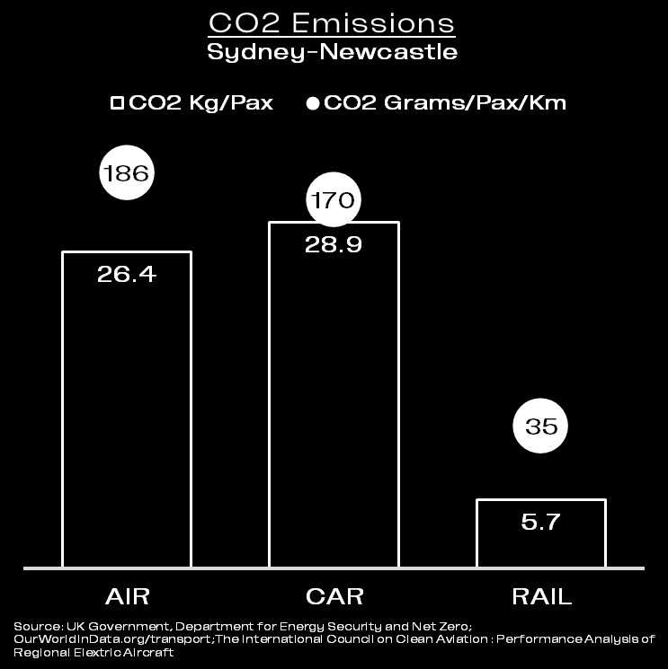
THE PROBLEM:
Arduous air travel, congested roads, expensive tolls and high fuel prices make traveling within and around Australia's major urban and regional areas time-consuming, costly and carbon-heavy

Slide 6
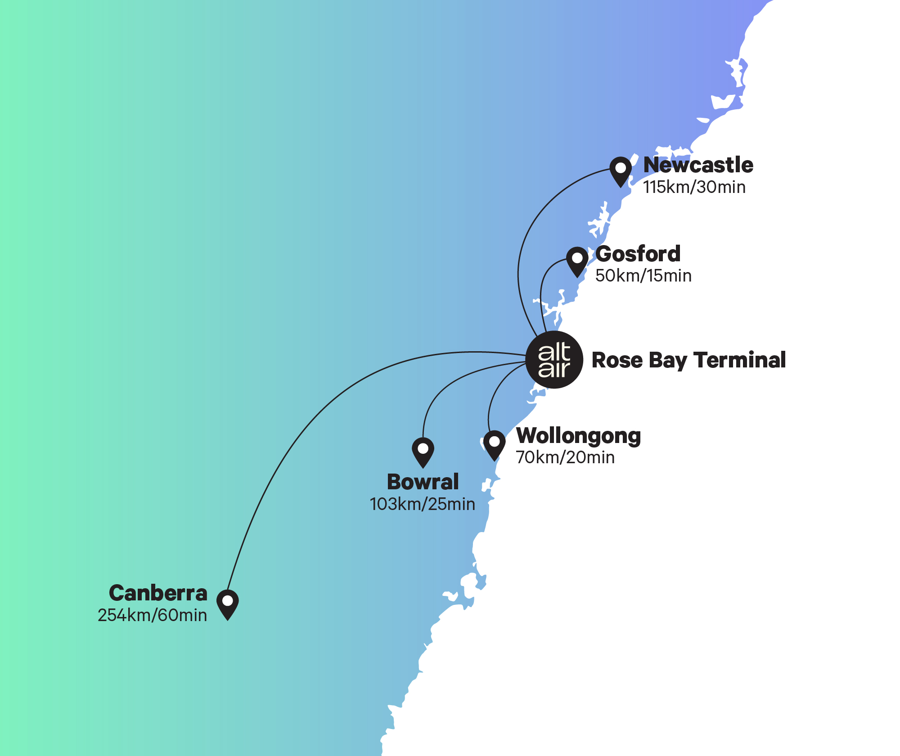
REGIONAL AIR MOBILITY (RAM) ROUTES - NSW
Alt Air is not creating demand — it is upgrading how millions of people already travel. ¹
Route | Annual Trips | Avg Drive Time | Alt Air Time | Time Saving
Central Coast | 8.34M | 2h 30m | 15 mins | ~90%
Wollongong | 5.82M | 2h 35m | 20 mins | ~90%
Newcastle | 2.94M | 4h 00m | 30 mins | ~85–90%
Canberra | 1.80M | 4h 29m | 60 mins | ~80%
Bowral | 0.96M | 3h 40m | 25 mins | ~85–90%
20M annual journeys across five key routes – a perfect fit for electric flight, unlocking up to 90% time savings and producing zero emissions from the flights.
SMALL SHARE = BIG BUSINESS
Catchment area - Sydney's CBD, Eastern Suburbs and Northern Beaches
¹Source DSpark mobility data

Slide 7
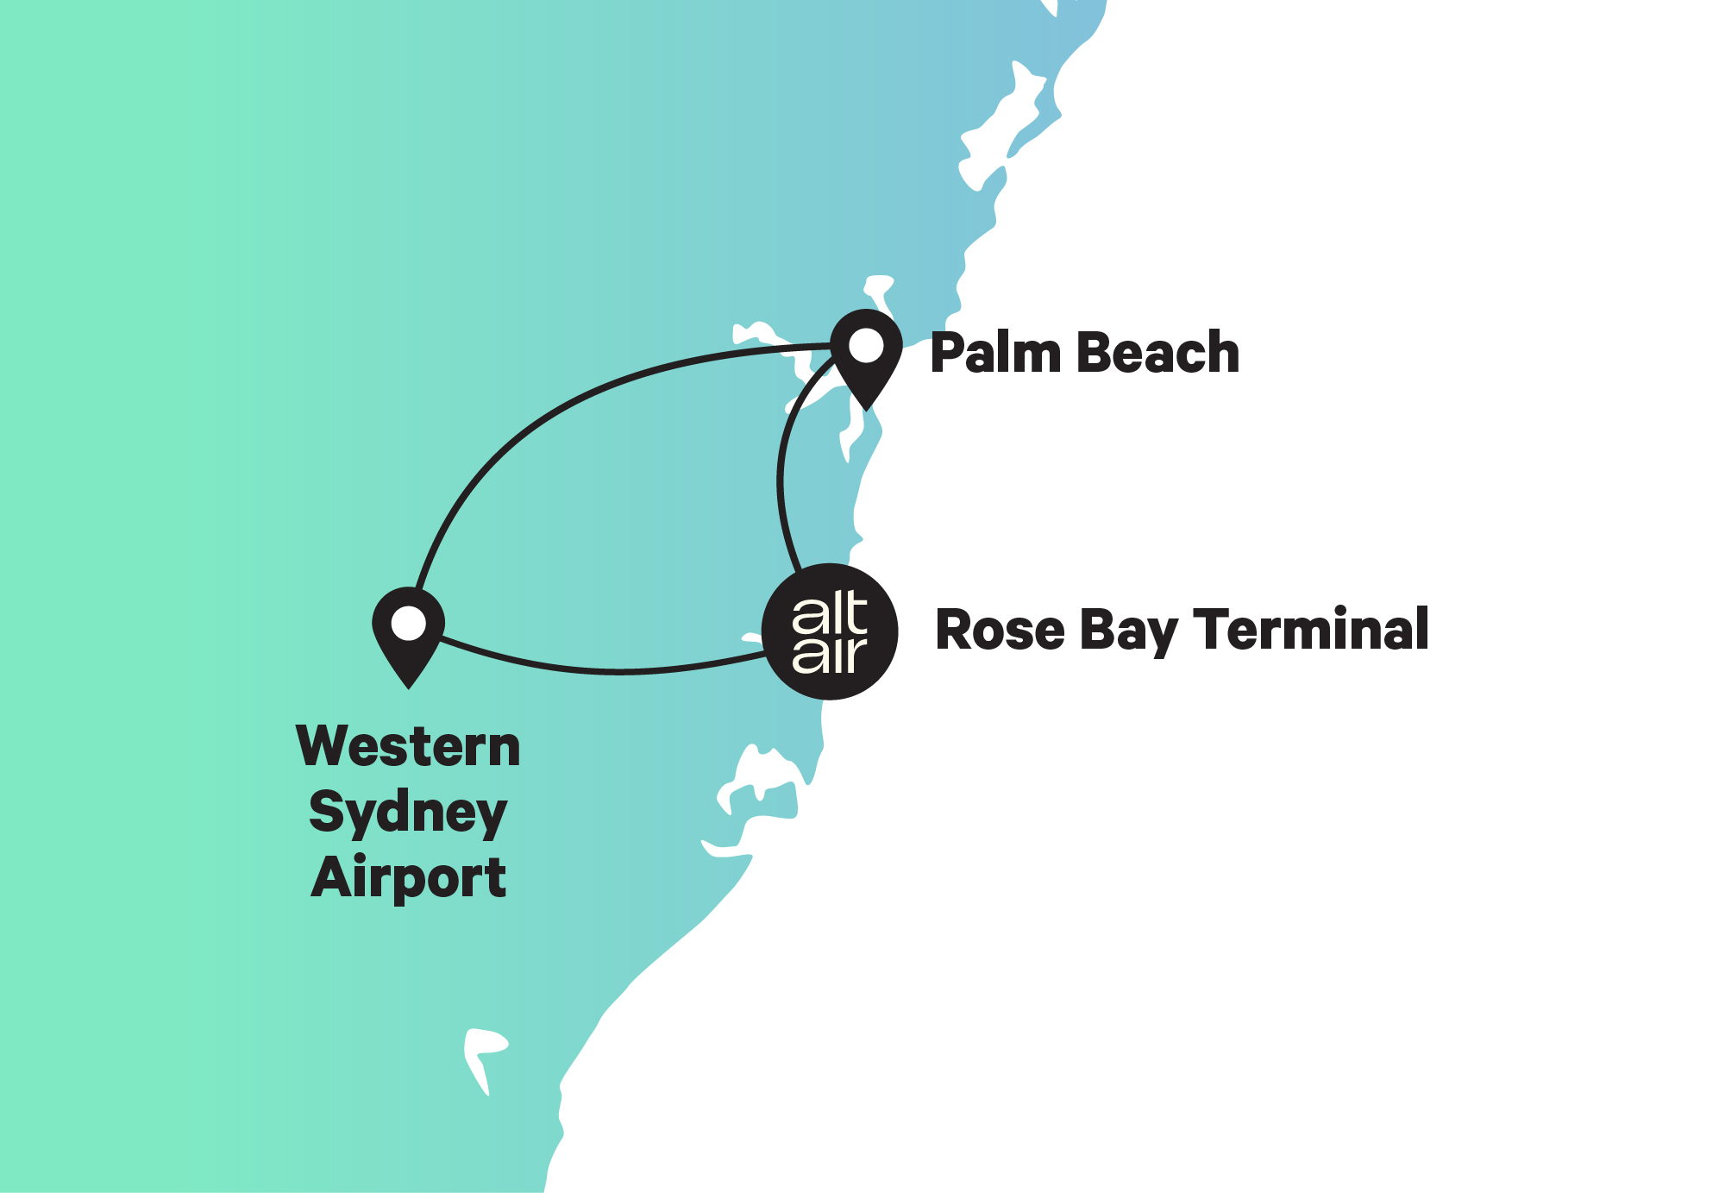
PREMIUM URBAN AIR MOBILITY (UAM) ROUTES - SYDNEY
Connecting Sydney’s most valuable catchments with next-generation air mobility
 | Rose Bay to Palm Beach¹ | Rose Bay to Western Sydney Airport | Palm Beach to Western Sydney Airport
Drive time | 75 – 100 mins | 70 – 100 mins | 100 – 120 mins
Flight time | 10 mins | 12 mins | 18 mins
Time saving | 90% | 85% | 85%
Uber Comfort fare | $200 | $200 | $275
Uber Black | $325 | $325 | $425
Alt Air target fare | $250 | $225 | $325
Existing annual journeys¹ | 2,570,000
Future annual journeys² |  | ~2,000,000 | ~1,000,000
SMALL SHARE = BIG BUSINESS
Western Sydney Airport opening 2026 forecasting
10m passengers per year by 2030 growing to 20m by 2045
¹Source DSpark mobility data. ²Based on WSA forecast of 10M annual passengers by 2030;
Alt Air catchment estimated at 20–30% (Eastern Suburbs, city and Northern Beaches).

Slide 8
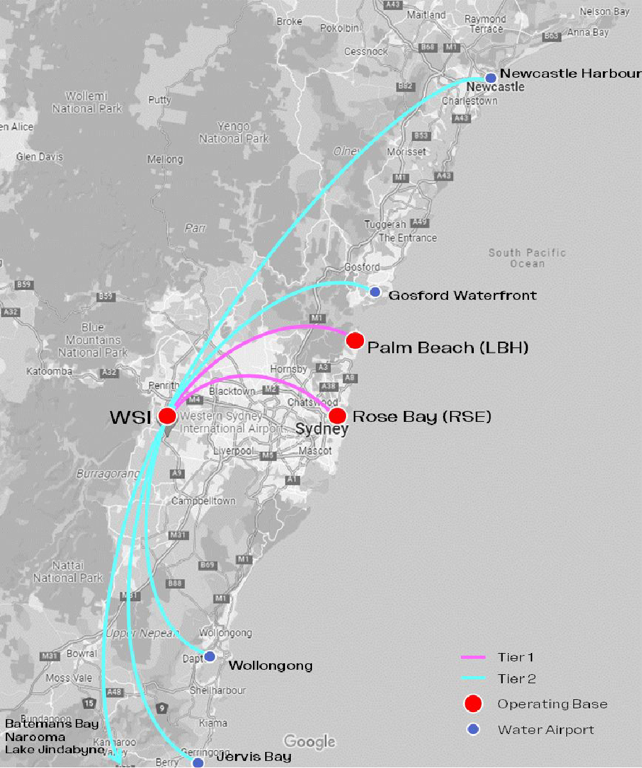
WESTERN SYDNEY AIRPORT – NETWORK EXPANSION ENGINE
Opening in 2026 WSA provides a unique opportunity to integrate Alt Air UAM and RAM services
Routes and times:
WSA to/from | Distance (Km) | Drive Time (min) | Flight Time (Min)
Rose Bay | 51 | 60-100 | 12
Palm Beach | 65 | 85-120 | 18
Newcastle | 115 | 130-180 | 30
Gosford | 78 | 75-100 | 21
Wollongong | 75 | 70-100 | 20
Jervis Bay | 140 | 140-180 | 33
Batemans Bay | 209 | 200-240 | 49
WSA opening with 10m pax/year, long term scale to 80m pax/year
Airline Integration
Booked as part of a single airline itinerary
Baggage checked through from urban departure points
From Australia’s first international airport at Rose Bay (1938) to its newest at Western Sydney Airport (2026) –
Alt Air is connecting the past and future of aviation.

Slide 9
ENERGY COST ANALYSIS
✈ CESSNA CARAVAN
⚡ EVE EVTOL
RAM Routes
Distance
Flight
time
Fuel cost
Cost / seat
Energy + batt dep
Cost / seat
Saving
vs Caravan
Central Coast
50 km
15 min
$144.00
$16.00
$31.02
$7.76
-52%
Wollongong
70 km
20 min
$192.00
$21.33
$32.73
$8.18
-62%
Newcastle
115 km
30 min
$288.00
$32.00
$36.55
$9.14
-71%
Bowral
103 km
25 min
$240.00
$26.67
$35.53
$8.88
-58%
Canberra *
254 km
60 min
$576.00
$64.00
$48.36
$12.09
-81%
* Canberra (254 km) exceeds Eve's 100 km range — would require eCTOL aircraft (planned 2029 phase). Figures shown for comparison only.
✈ CESSNA CARAVAN
⚡ EVE EVTOL
UAM Routes
Distance
Flight
time
Fuel cost
Cost / seat
Energy + batt dep
Cost / seat
Saving
vs Caravan
Rose Bay → Palm Beach
40 km
10 min
$96.00
$10.67
$30.17
$7.54
-29%
Rose Bay → WSA
51 km
12 min
$115.20
$12.80
$31.11
$7.78
-39%
Palm Beach → WSA
65 km
18 min
$172.80
$19.20
$32.30
$8.07
-58%
eVTOL total cost / seat
Caravan fuel cost / seat
Saving vs Caravan
Battery dep. / seat
$8–$12
$11–$64
29–71%
$6.69
electricity + battery dep. (all routes)
jet fuel only (all routes)
lower energy cost per seat
$26.77/flight ÷ 4 seats
KEY ASSUMPTIONS
Caravan fuel burn
eVTOL energy
NSW electricity
Battery pack
Cycle life → dep/flight
240 L/hr @ $2.40/L
500 Wh/km
$0.34 / kWh
(AER retail average 2025–26)
~175 kWh × $200 USD/kWh
= AUD ~$53,550
2,000 cycles → $26.77/flight
Energy and battery depreciation only — pilot, maintenance, insurance and overhaul costs are additional for both aircraft types. All figures AUD.

Slide 10
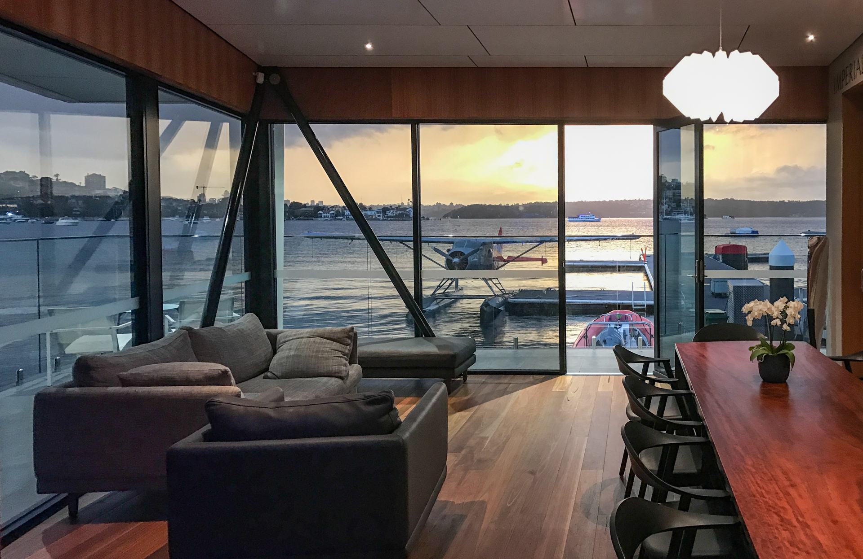

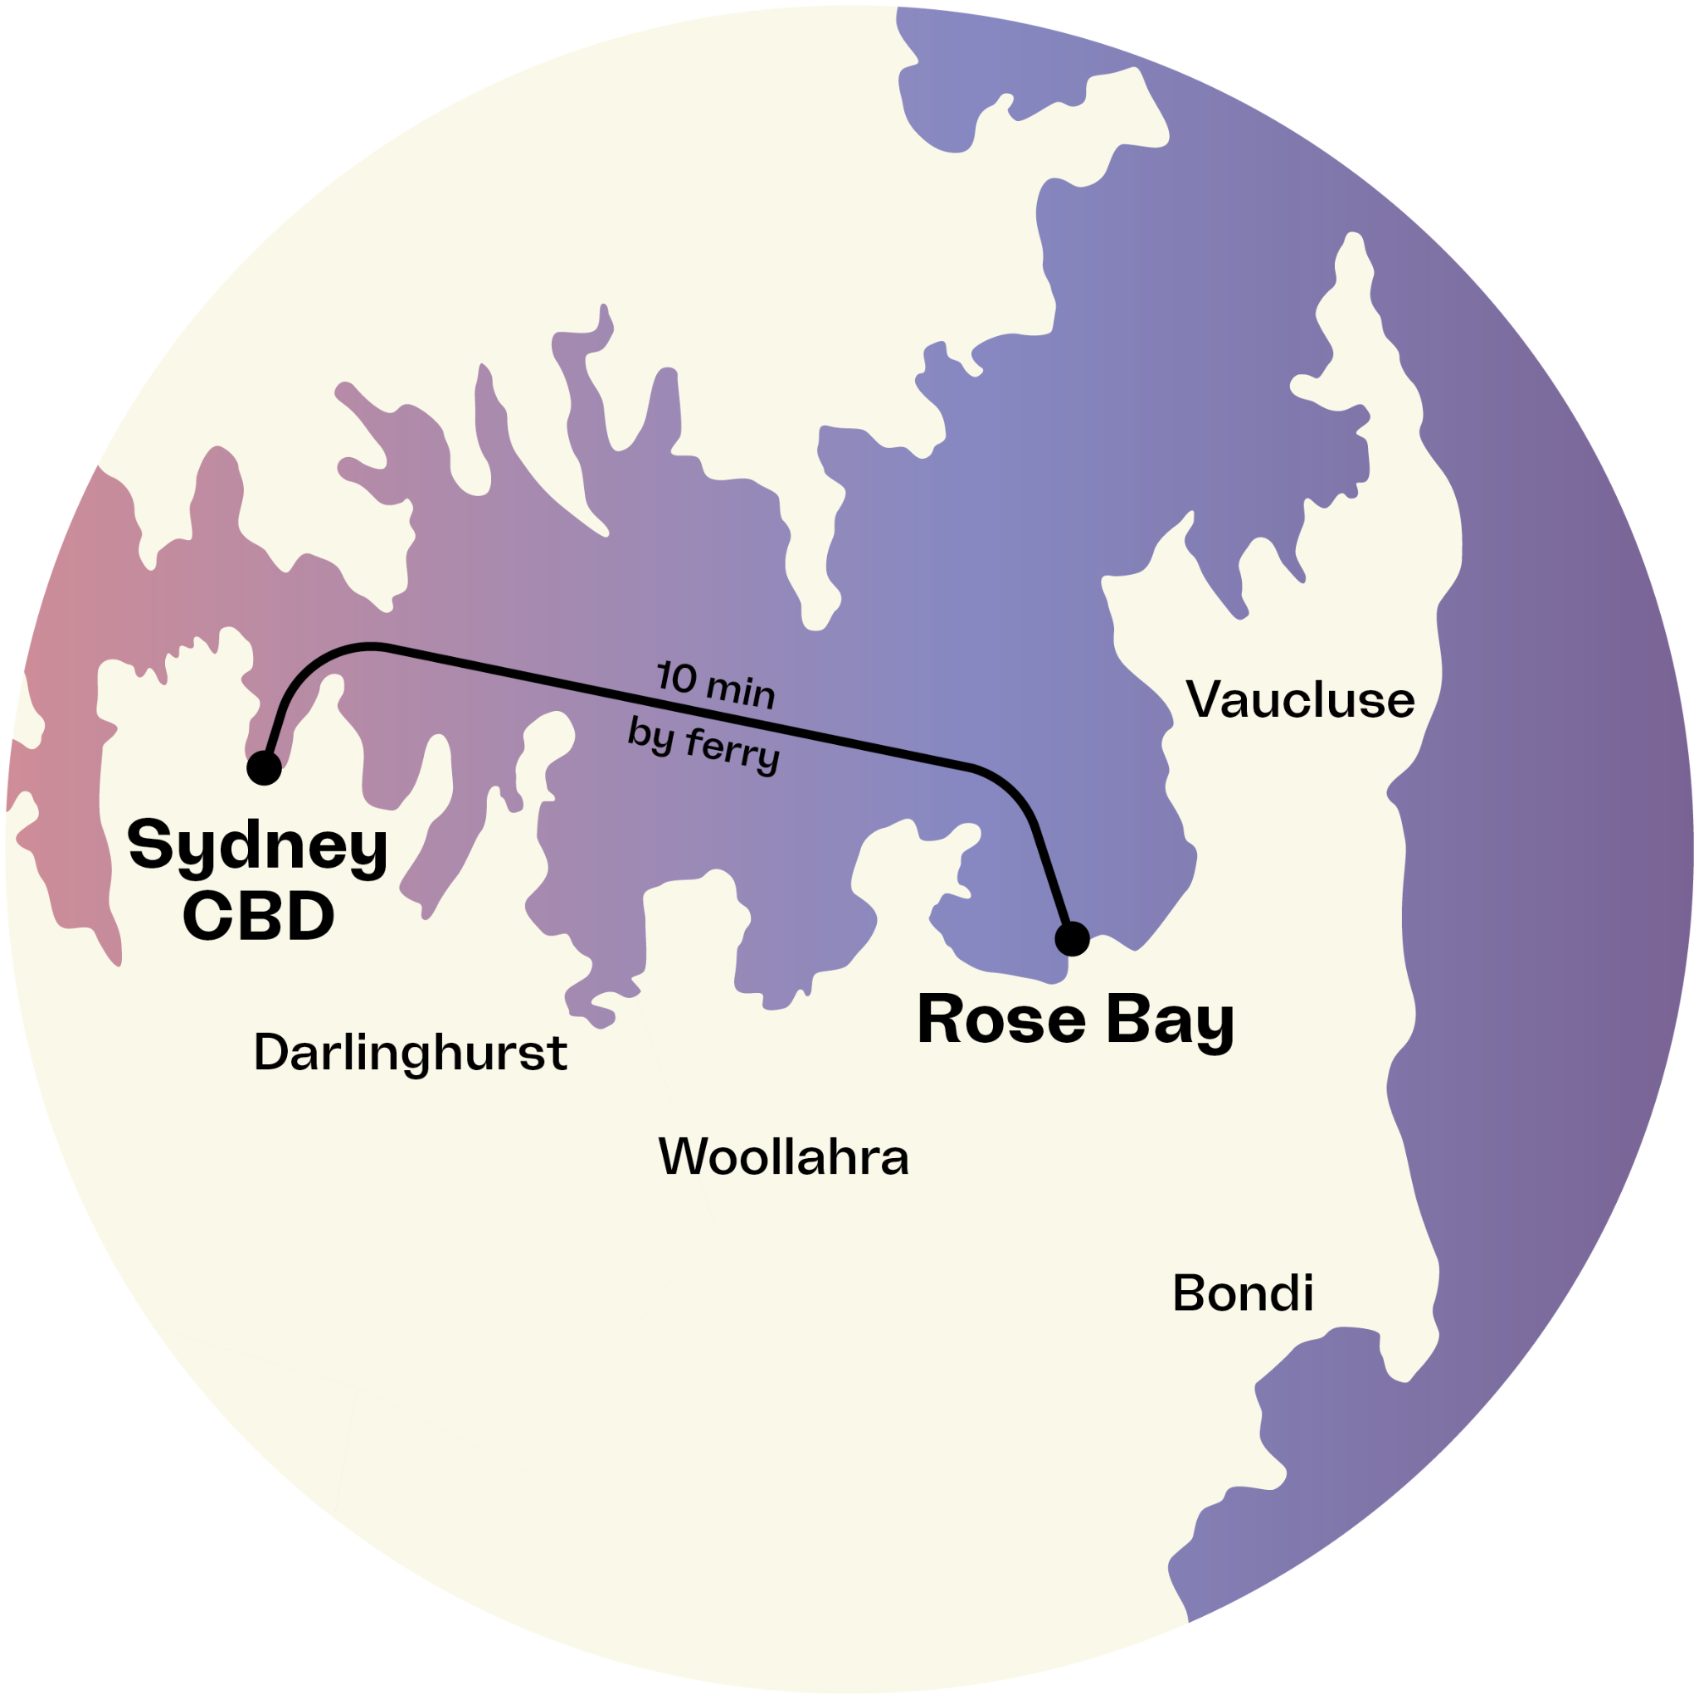



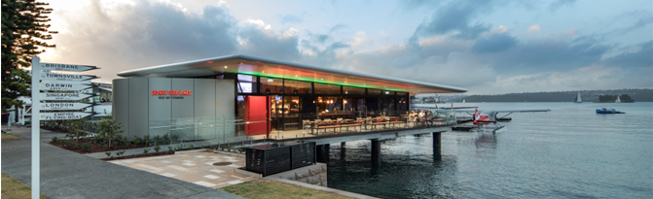

ROSE BAY
A unique platform to launch advanced air mobility in NSW
Long-term lease on prime location
Purpose built urban marine aviation infrastructure, under a long term lease from Transport for NSW
High yield customer catchment area
Rose Bay is surrounded by the top 6 highest income and property value suburbs in Australia
Free Airspace over Sydney Harbour
Airspace over Sydney Harbour from 0-1,000ft is restricted to seaplane/helicopter flights only with no clearance required
Intermodal transport hub
~60 daily ferry services to/from Sydney CBD and ~30 services to/from Watsons Bay
“Social license”
Approaching 100 years of seaplane operations from the same site engenders significant community & stakeholder support. Alt Air is building the future of air mobility from one of the world’s most iconic aviation locations

Slide 11
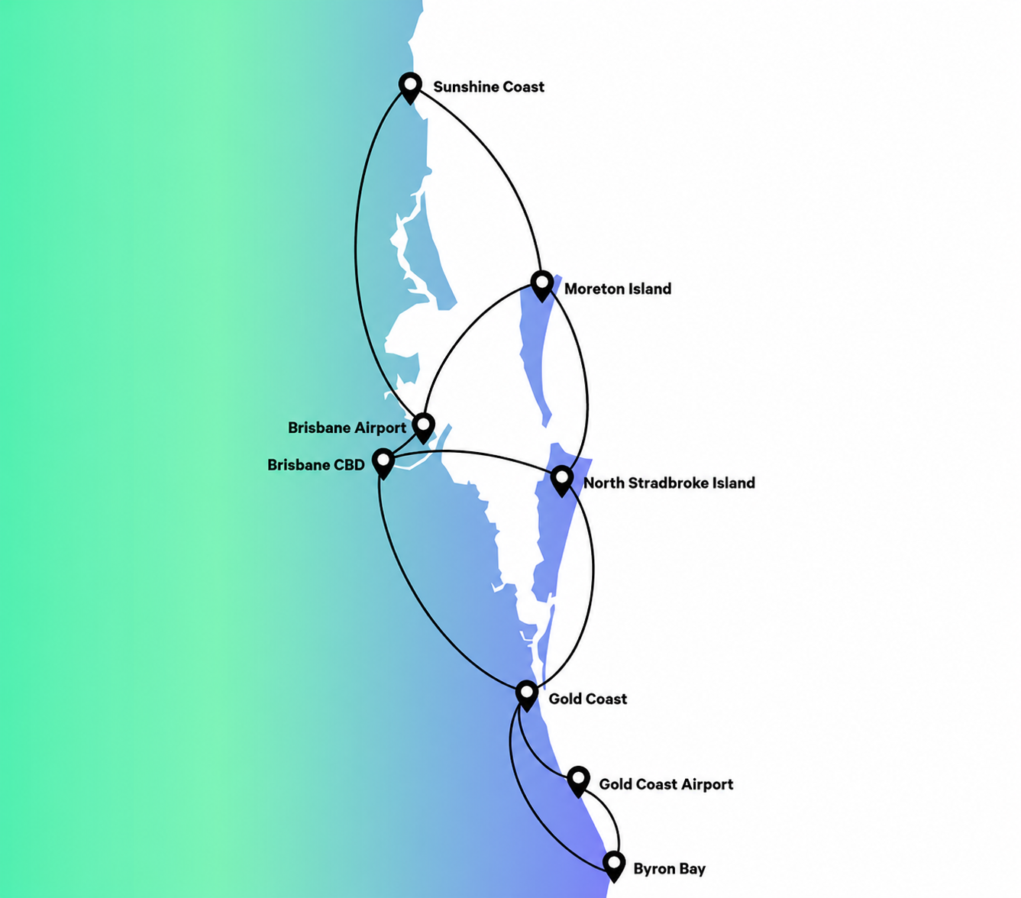
SOUTH EAST QUEENSLAND (SEQ): A HIGH-GROWTH, MULTI-CITY AAM MARKET
South East Queensland population projected to grow from 3.8 million to 5.4 million by 2041
Transport demand forecast to increase by ~30% by 2031¹
One of Australia’s fastest growing and most spatially dispersed urban regions
Alt Air is in active discussions with Queensland infrastructure partners for Brisbane operations
“
“As SEQ prepares to host the largest sporting event in the world, the Brisbane 2032 Olympic and Paralympic Games, the use of AAM services, supported by transformational technologies in energy storage, can provide a lasting legacy for the people of SEQ by delivering a region that is connected, diverse, innovative and sustainable”. ¹
¹Bringing Advanced Air Mobility (AAM) to Brisbane South East Queensland SEQ Council of Mayors

Slide 12
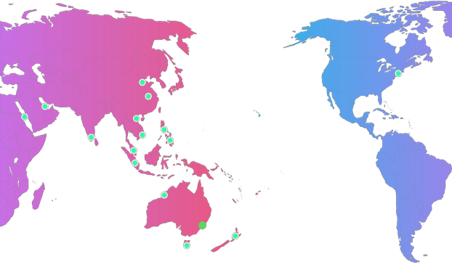
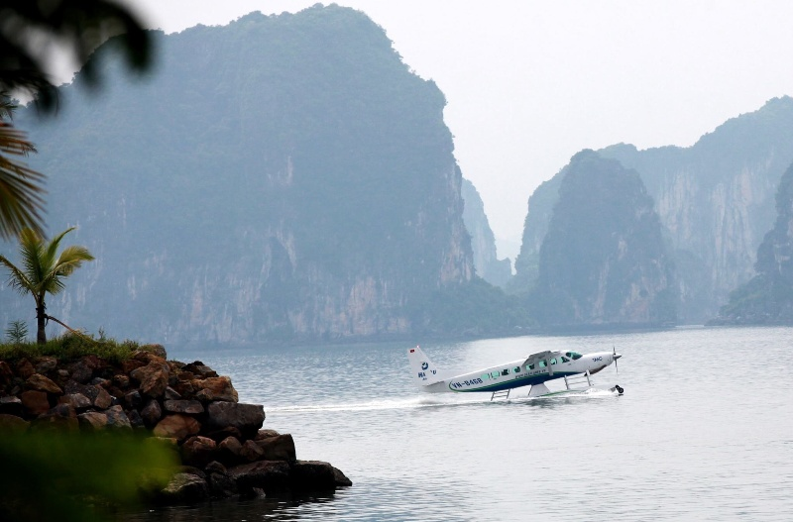














The Alt Air team has led the implementation of amphibious services for 16 operators in 11 countries
throughout our region.
The AAM opportunity
AAM will dwarf amphibious aviation in scale, market size and regulatory complexity. The export demand for pilot training, engineering certification, vertiport operations and operational IP will be an order of magnitude greater.
Pilot and Engineering training
APAC operators will need AAM-certified pilots and engineers at a scale the region cannot initially supply. An Australian-based training centre drawing on operational experience, capability and regional relationships — becomes the natural hub for pilot type-rating, instructor and regulatory compliance training across the Asia-Pacific.
500M+ people in island and coastal APAC underserved by conventional aviation — the RAM opportunity
100M+ premium urban commuters across APAC megacities losing hours daily to congestion — the UAM opportunity
Alt Air's Australian-first position creates a significant export opportunity across Asia-Pacific — from pilot and technical training to infrastructure models and operational playbooks.

Slide 13
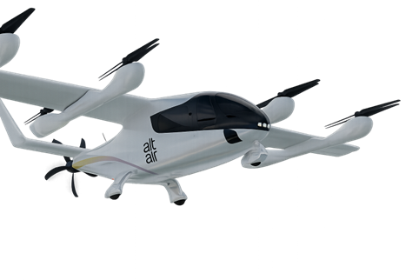
13
THE WAY FORWARD: HOW GOVERNMENT CAN HELP
A whole-of-government response is needed — Federal, State, Local Governments working closely with industry partners will enable a successful AAM launch in Australia
01
Adopt the Florida Model
02
PPP Infrastructure Funding
Develop an enabling legislative framework: define AAM and vertiports in State transport legislation, designate a state AAM lead within Department of Transport , streamline site approval pathways.
Apply the proven Rose Bay PPP model to vertiport infrastructure. Under this model the government funds construction; the operator delivers services and pays a long-term lease. This delivers public infrastructure with long term commercial returns to government while unlocking private operator investment.
03
Convene Industry Partnerships
04
Vertiport Site Access & Planning
Facilitate introductions to aligned strategic investors — airlines, infrastructure funds, transport operators, property developers and energy companies. AAM succeeds when private and public capital work together; government is uniquely positioned to convene those conversations.
Early engagement on preferred vertiport locations within cities and inner regional locations with demonstrated demand. Identify sites multi-modal transport interchange nodes.
05

Slide 14


14
01
05
Aaron@flyaltair.com.au

